Slide 1
Cotton Disease Prediction Using Convolutional Neural Networks (CNN)
- Vipul Purohit

Slide 2
Introduction
Cotton is one of the most important cash crops in the world, contributing significantly to the global economy. However, cotton crops are vulnerable to various diseases caused by pathogens such as fungi, bacteria, and viruses. Early detection and diagnosis of these diseases are crucial to prevent crop loss and ensure a healthy cotton yield.

Slide 3
Problem Statement
The aim of this project is to develop a CNN-based model that can accurately predict the presence of diseases in cotton plants based on images of their leaves. The model should be capable of distinguishing between healthy cotton plants and those affected by various diseases, such as cotton leaf spot, cotton boll rot, and cotton leaf curl virus, among others.

Slide 4
Objectives
The objective of using Convolutional Neural Networks (CNNs) for cotton disease prediction is to accurately identify and classify diseases in cotton plants based on images.
Detect diseases at an early stage to allow for timely intervention and treatment, minimizing crop damage.
Achieve high accuracy in disease detection to prevent misdiagnosis and ensure effective disease management.

Slide 5
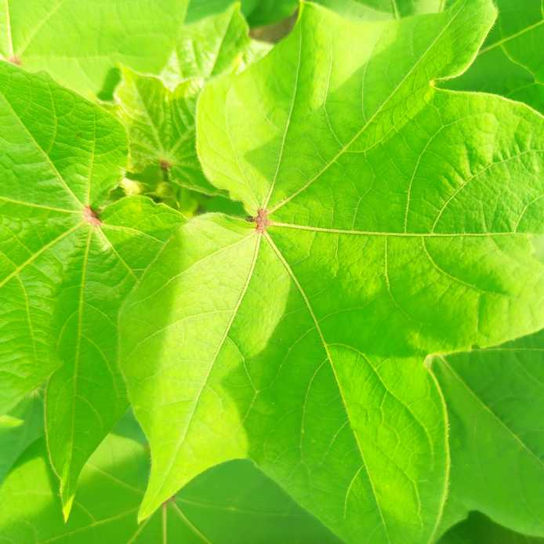
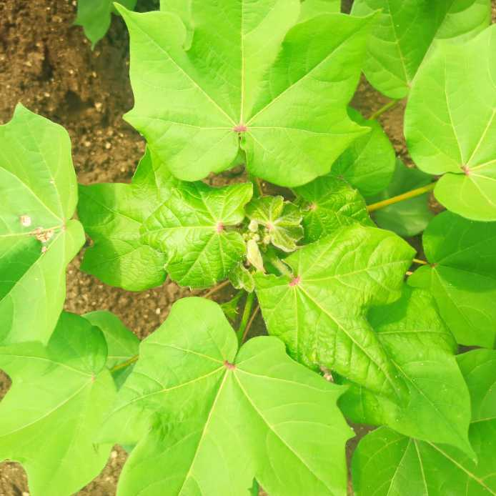
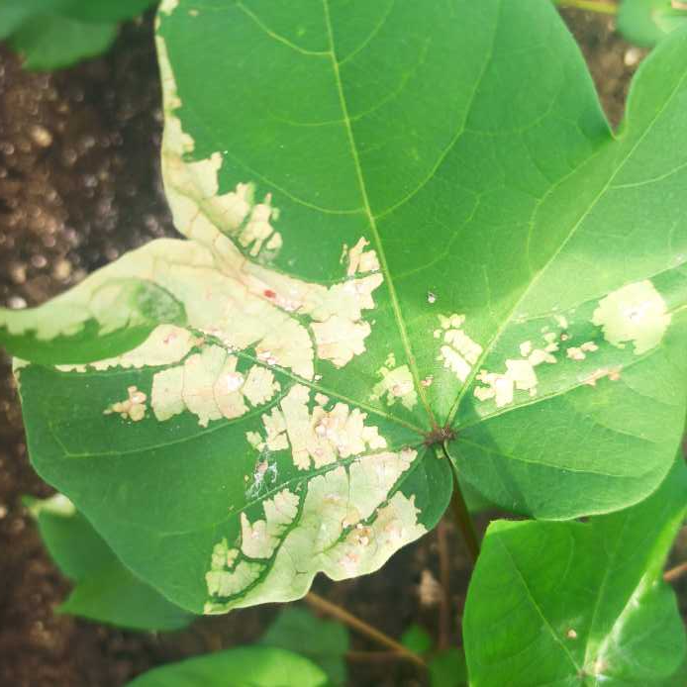
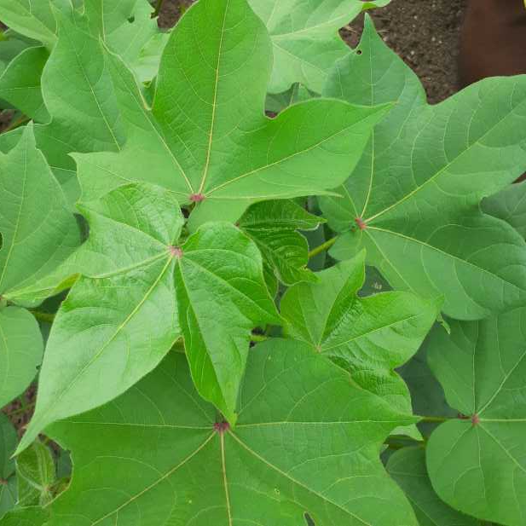
Input Data Images
Fresh Cotton Leaf
Diseased Cotton Leaf
Fresh Cotton Plant
Diseased Cotton Plant

Slide 6
Model Architecture :-
Layers | Filters | Filter size | Activation
Convolutional layer | 128 | (3,3) | Relu
Convolutional layer | 128 | (3,3) | Relu
Batch Normalization layer
Max pooling layer
Convolutional layer | 256 | (3,3) | Relu
Convolutional layer | 256 | (3,3) | Relu
Batch Normalization layer
Max pooling layer
Convolutional layer | 512 | (3,3) | Relu
Convolutional layer | 512 | (3,3) | Relu
Convolutional layer | 512 | (3,3) | Relu
Batch Normalization layer
Max pooling layer
Flatten layer
 | Neurons
Fully connected Dense layer-1 | 128 |  | Relu
Fully connected Dense layer-2 | 128 |  | Relu
Dropout layer
Output layer | 4 |  | Softmax

Slide 7
0.001,
0.001,
Parameters
Optimizer = Adam
Learning rate = 0.001
Loss = sparse_categorical_crossentropy
Metrics = accuracy
Epochs = 1000 (with using early stopping)

Slide 8
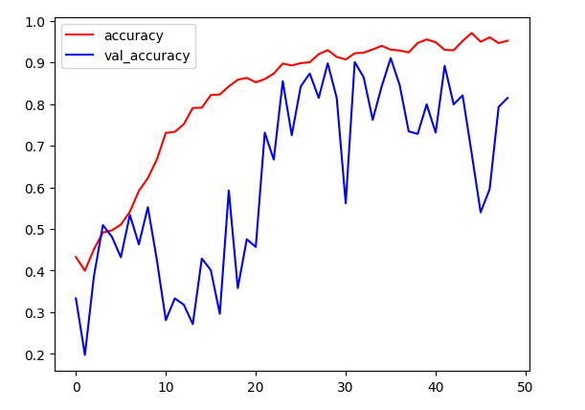
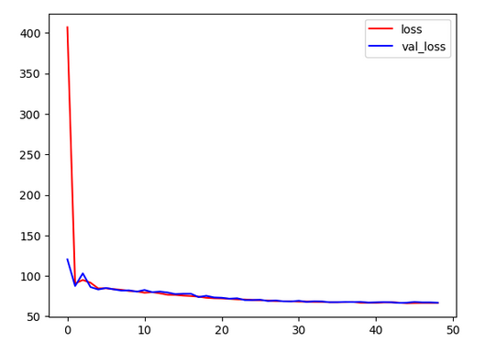
Accuracy and loss of Builded model:-

Slide 9
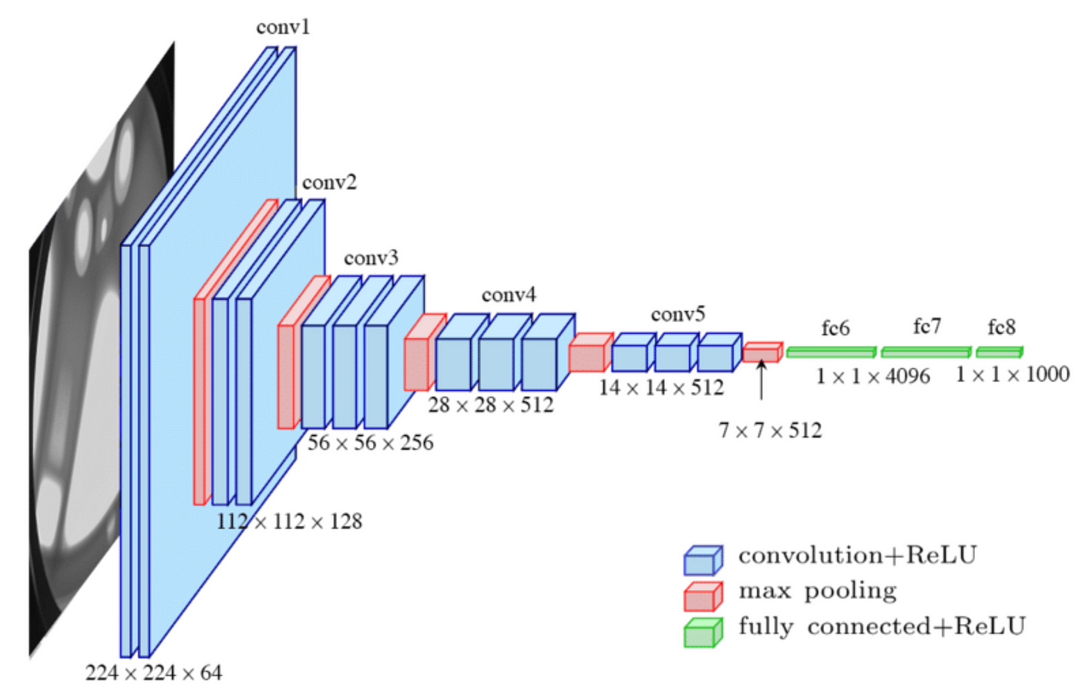
VGG16 Model Architecture:-

Slide 10
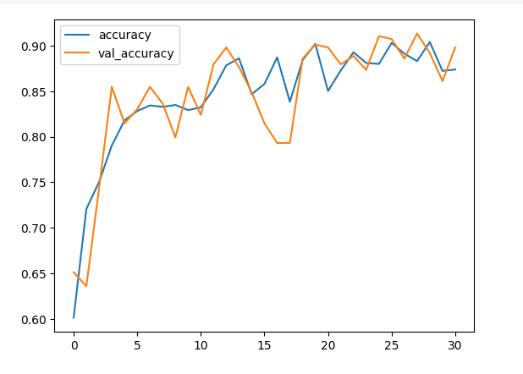
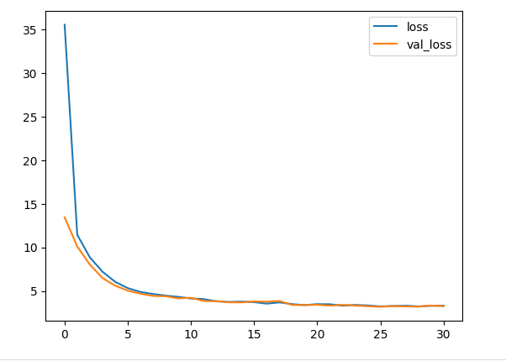
Accuracy and Loss with VGG16 model :-

Slide 11
Evaluation Metrics Table :-
Models | Accuracy
Builded Model | 95.23%
VGG16 model | 87.39%

Slide 12
Conclusion
In this project, I developed architecture of Convolutional Neural Network (CNN) models to solve a problem of Cotton disease plant on the basis of normal & disease cotton plant images .Initial model achieved an accuracy of 95.23% & validation accuracy was 81.48%.
To overcome overfitting in my first model, I implemented transfer learning ,Where I used VGG16 model architecture. After implementation of VGG16 Model my accuracy is 87.39% & validation accuracy is 89.81%.

Slide 13
Thank You.

